Slide 1
Why Is
English Spelling
So Weird?
James Harbeck

Slide 2
In the beginning
Latin alphabet:
A B C D E F G H I L M N O P Q R S T V X

Slide 3
In the beginning
Latin alphabet:
A B C D E F G H I K L M N O P Q R S T V X Y Z

Slide 4
In the beginning
Latin alphabet:
A B C D E F G H I K L M N O P Q R S T V X Y Z
Anglo-Saxon sounds:
p b t d k g tʃ m n f θ s ʃ h r j w l i y u e o æ ɑ

Slide 5
Adaptations
ÀÁÂÃĀĂȦÄẢÅǍȀȂĄẠḀẦẤẪẨẰẮẴẲǠǞǺẬẶÆǼǢḂƁḄḆƂƄĆĈĊČƇÇḈḊƊḌḎḐḒĎĐƉƋÈÉÊẼĒĔĖËẺĚȄȆẸȨĘḘḚỀẾỄỂḔḖỆḜƎƐḞƑǴĜḠĞĠǦƓĢǤĤḦȞǶḤḨḪĦÌÍÎĨĪĬİÏỈǏỊĮȈȊḬƗḮĲĴḰǨḴƘḲĶĹḺḶĻḼĽĿŁḸḾṀṂƜǸŃÑṄŇŊƝṆŅṊṈȠÒÓÔÕŌŎȮÖỎŐǑȌȎƠǪỌƟØỒỐỖỔȰȪȬṌṐṒỜỚỠỞỢǬỘǾƆŒṔṖƤŔṘŘȐȒṚŖṞṜƦŚŜṠŠṢȘŞṤṦṨṪŤƬƮṬȚŢṰṮŦÙÚÛŨŪŬÜỦŮŰǓȔȖƯỤṲŲṶṴṸṺǛǗǕǙỪỨỮỬỰṼṾƲẀẂŴẆẄẈẊẌỲÝŶỸȲẎŸỶƳỴŹẐŻŽȤẒẔƵ

Slide 6
We used to have…
ð
þ
ƿ
æ

Slide 7
Divergence
head
earth
heart
…Welcome to Middle English.

Slide 8

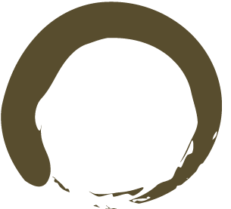

The French influence
cwen → queen
cyning → king
c → ch
sc → sh, sch
cj → dg, gg, g
hw → wh
sinder → cinder
is → ice
feond → fiend

Slide 9
English is back in power
Signet Office
Chancery standard

Slide 10
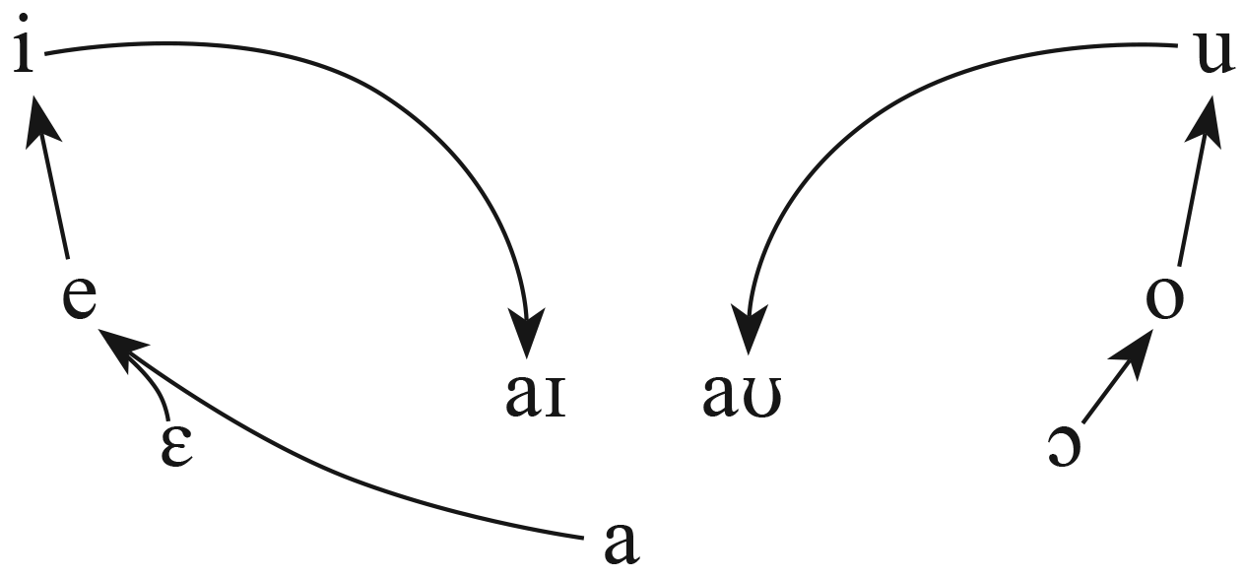
Great Vowel Shift!

Slide 11
Our vocabulary
Of the 10,000 most common English words, about 1/3 come from Old English.
Of the 1,000 most common English words, more than 800 come from Old English.
Middle English: ~100,000 words in vocabulary
1700: >20,000 words in vocabulary

Slide 12
Latin!
Latin pronunciation changed with English:
  Nil nisi bonum → [nɪl naɪ saɪ bəʊ nʌm]
  ratio → [reɪ ʃəʊ]
  Veni vidi vici → ?
  via → [viə] or [vajə]?

Slide 13
Latin!
Latin pronunciation changed with English:
  Nil nisi bonum → [nɪl naɪ saɪ bəʊ nʌm]
  ratio → [reɪ ʃəʊ]
  Veni vidi vici → ?
  via → [viə] or [vajə]?
English spelling changed to recall Latin:
  det + debitum = debt
  peple + populum = people
  ile, iland + insulum = isle, island
  faucon + falx = falcon

Slide 14
The printing press
William Caxton, 1476: the first in England
Commonly used as the boundary between Middle English and Early Modern English
Typesetters would adjust spellings to help the text fit
Caxton used the Kentish dialect
Type brought European typesetters with their own attitudes to spelling
It also brought European fonts without certain letters

Slide 15
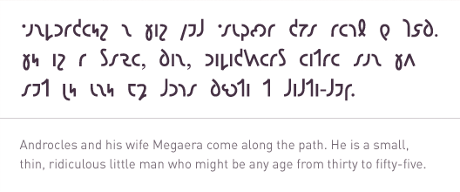
Reform!
1551: The Opening of the Unreasonable Writing of our Inglish Toung, John Hart
  v → u/v: u for the vowel, v for the (newer) consonant
  i → i/j: i for the vowel, j for the (newer) consonant
  vv/uu → w
George Bernard Shaw
  abolish apostrophes
  new alphabet:

Slide 16
Standardization?
How do you pronounce vase?
How about cot, caught, and court?

Slide 17
More reforms
John Hart advocated losing some excrescent letters – e.g., sette → set
Richard Mulcaster in The Elementarie (1582) advocated making it consistent, even if not phonetic
Robert Cawdrey in A Table Alphabeticall (1604) also standardized
Jonathan Swift in “Proposal for Correcting, Improving and Ascertaining the English Language” (1712)…

Slide 18
…“the maiming of our Language” is caused by “a foolish Opinion, advanced of late Years, that we ought to spell exactly as we speak; which beside the obvious Inconvenience of utterly destroying our Etymology, would be a Thing we should never see an End of.”
Was Swift serious about this? Hmm. Were others of this opinion quite unironically? Yes.

Slide 19
Correct spelling or…
…correct pronunciation?
–ing had been pronounced /ɪn/ for a long time, but schoolmasters reversed that starting in the 1700s.

Slide 20
Noah Webster
1806 Compendious Dictionary:
  feather → fether
  definite → definit
  build → bild
  tongue → tung
  island → iland
  magick → magic
  musick → music
  colour → color
  centre → center
  analyse → analyze
  travelling → traveling
  cheque → check
  anaemia → anemia

Slide 21
How would you spell…
[kridʒən]: krijan? cregion? kreejun? qredian?
[kælfun]: kalfun? calphoon? calfune? calghoughgn?
[kaɪlɹ̩]: kyler? keillor? chilor? cailure? khailar?

Slide 22
Ways for spelling to be weird
When the spelling was set, it matched the pronunciation reasonably, but the pronunciation moved on and the spelling didn’t: hate, head, heat, heart, daughter, laughter
The spelling was set using a non-phonetic convention that had arisen because of pronunciation shift: colour, meter
The spelling was altered to match standards of another language held in higher esteem at the time: queen, fiend
The spelling was altered for reasons related to its printed form: son, Menzies

Slide 23
Ways for spelling to be weird
The spelling was altered to match its etymology, or what was thought to be its etymology, and the pronunciation didn’t change: debt, people, island
The spelling was altered by mistake or ignorance: ghost
The spelling was altered to match etymology, or just by mistake, and the pronunciation changed to match it: schedule, fault
The word was borrowed from another language and not respelled, and the pronunciation was adapted to English pronunciation: yacht, yogurt, sauna, ski

Slide 24
Ways for spelling to be weird
The word was borrowed from another language and partially modified or respelled, and is pronounced under the influence of English phonotactics: analyse, creation
The word was borrowed from another language and not respelled, and the pronunciation was kept as in the source language, or as close as possible to it: corps, ballet
The word was borrowed from another language and respelled or transliterated, and then the standards of pronunciation changed: Genghis Khan, Kahlil Gibran, Peking

Slide 25
Ways for spelling to be weird
The word was borrowed from another language and transliterated by conventions taken from a third language that matched a pronunciation of the source language at one time but didn’t match by the time the word was borrowed and don’t now either: physic
The word was borrowed from another language and transliterated suitably, but is usually mispronounced by analogy with the pronunciation of words taken from other languages: Beijing

Slide 26
Ways for spelling to be weird
The word was borrowed from another language and the spelling retained, but the pronunciation has commonly been changed to match standards from a third language: bruschetta
The word is spelled so that it could be pronounced as it originally was, but the pronunciation has changed, perhaps by analogy with other words: vacuum, sew
Nobody’s completely sure exactly what the heck happened: busy

